Slide 1
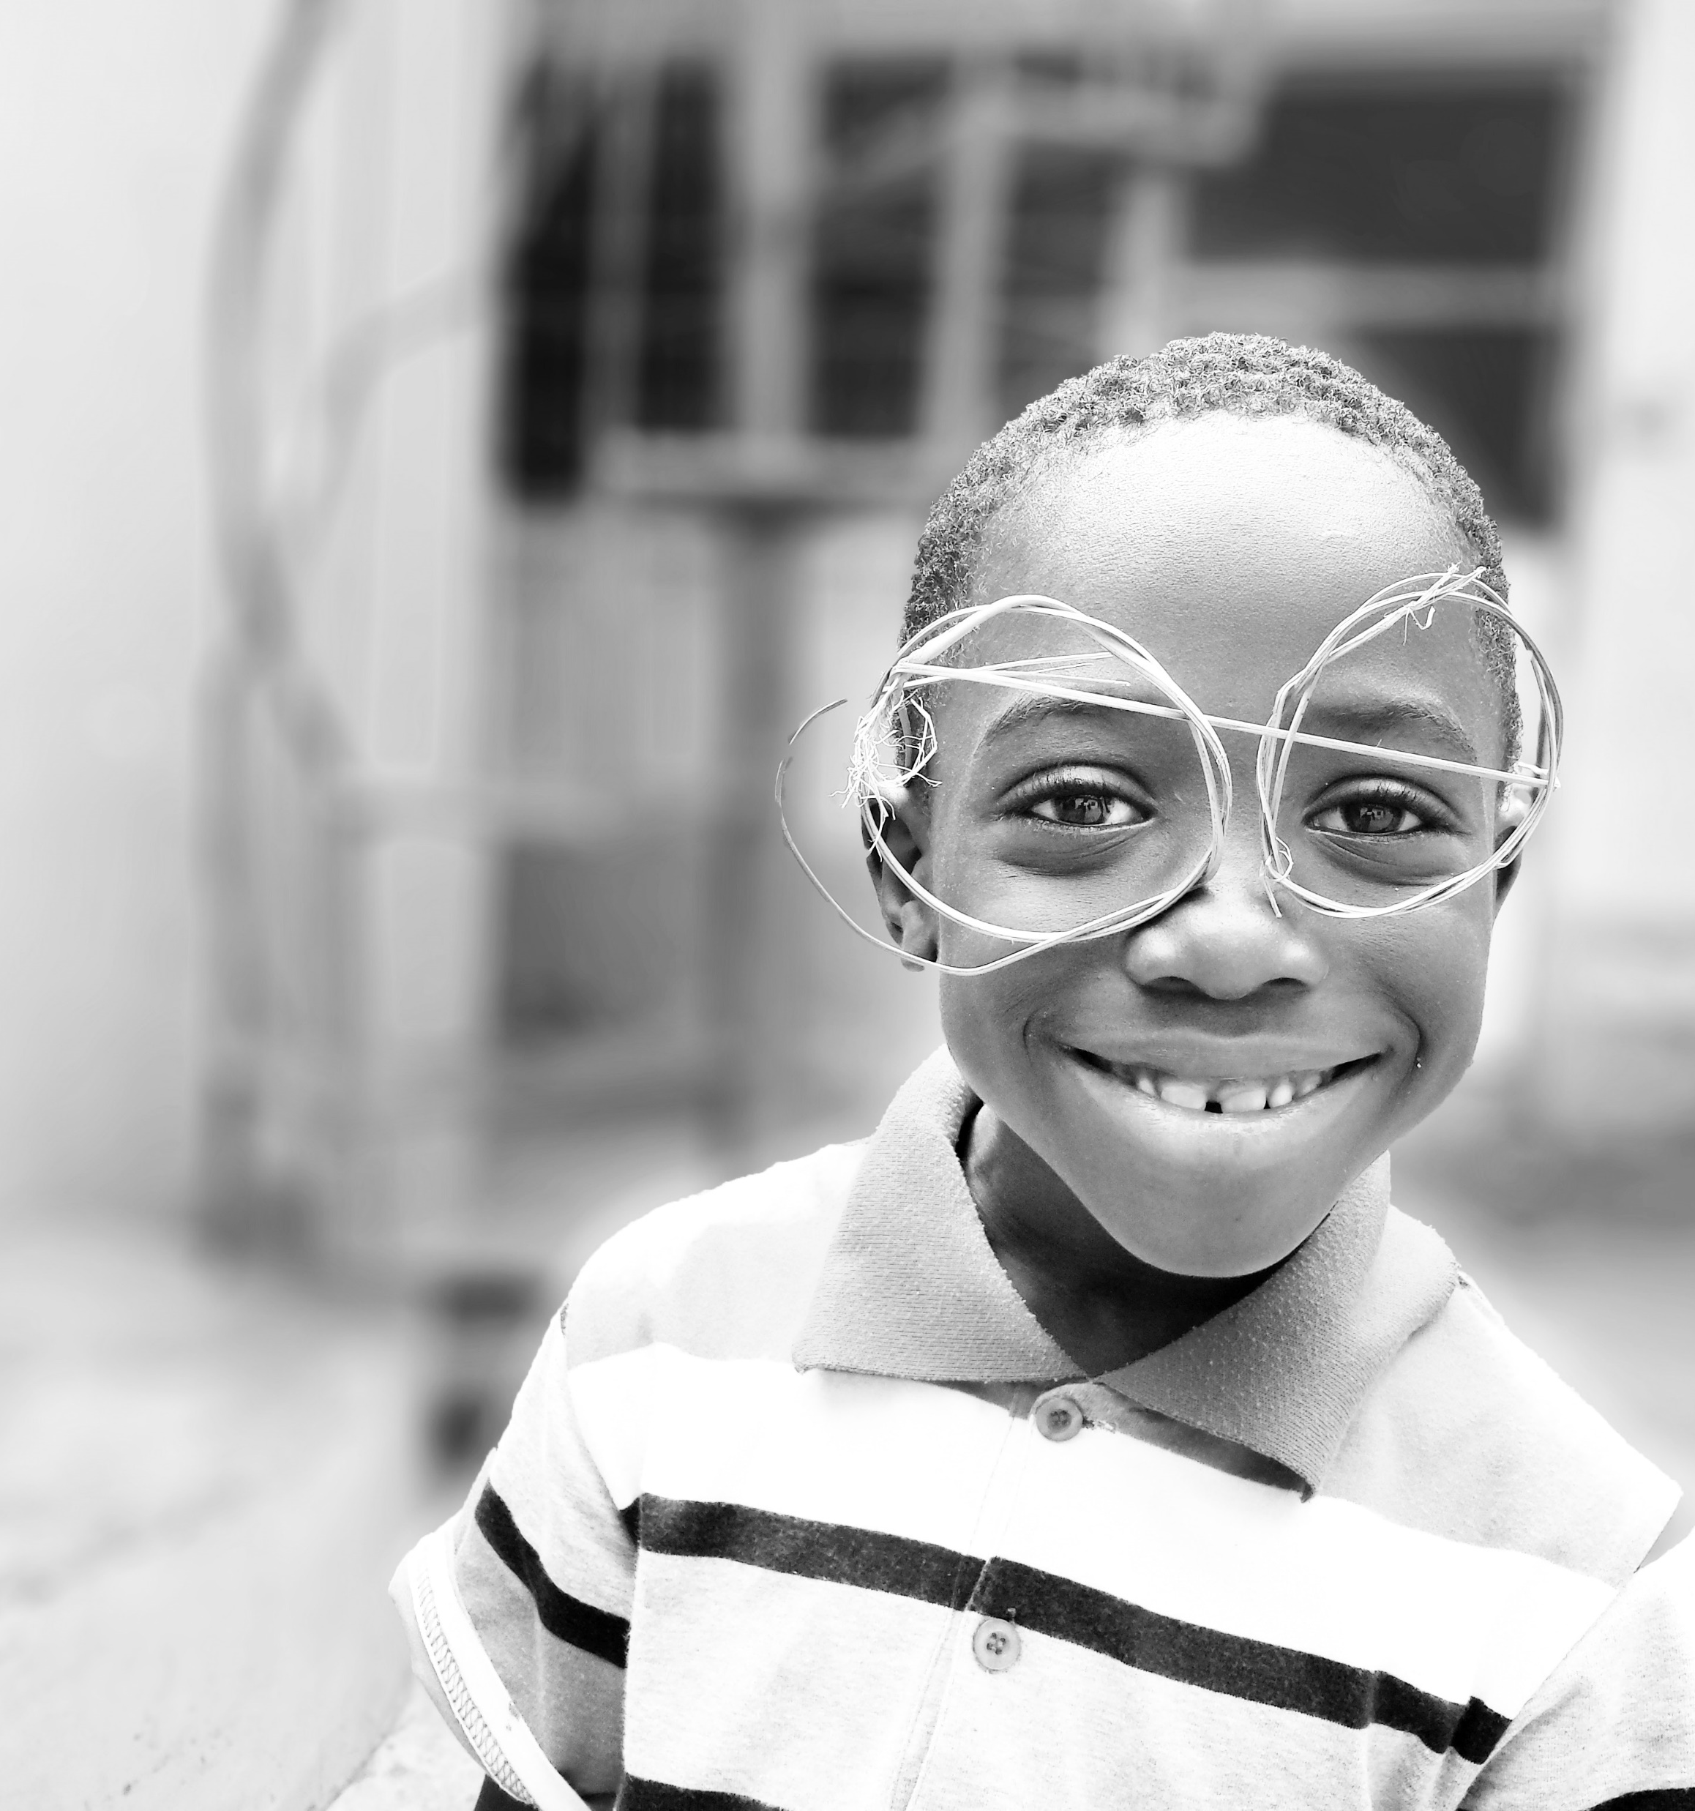


Do you see
what I see?

Slide 2
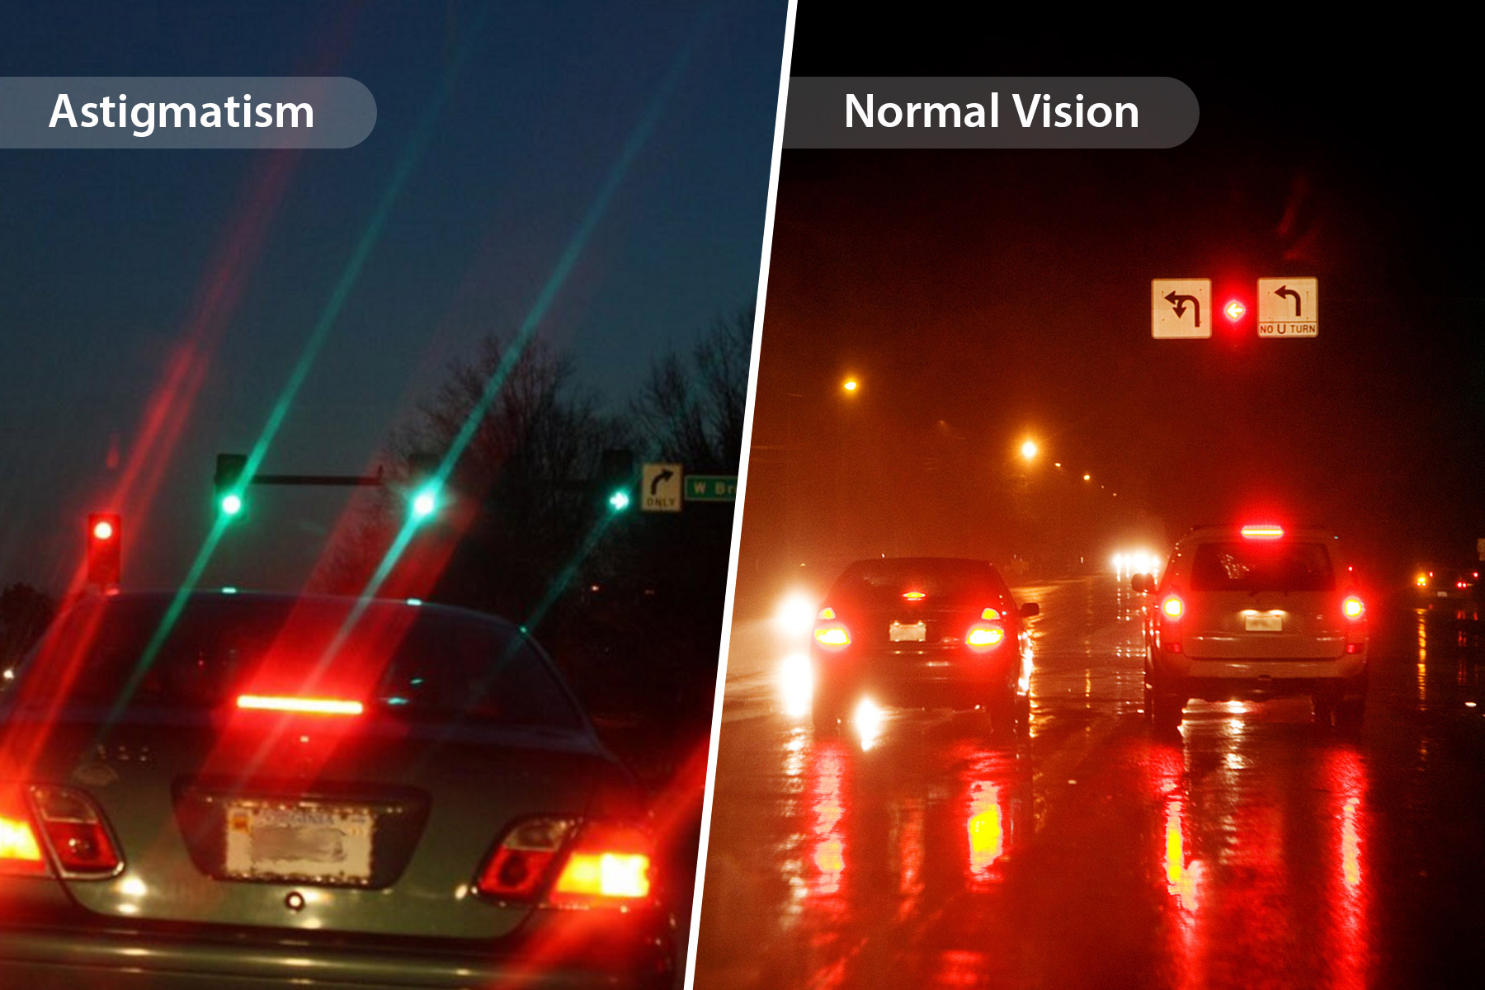
Photo courtesy of WebMD
Notes:
Hello, My name is Heather Martin and I am a project manager with the Child Health & Development Project also known as Mississippi Thrive. I promote Vroom across the state of Mississippi, and I promote Mind in the Making alongside the Campaign For Grade Level Reading across the state as well. This past December I encountered a shift in the reality of how I had always seen things. I was scrolling through the internet and this image appeared on my phone. I have known for several years now that my oldest daughter had astigmatism, but I never really realized how differently she saw things. When I showed her these two images with no other information and asked what was different she noted that a green light appeared in the image on the left that did not appear in the image on the right…also my daughter noted that one car appeared in the image on the left but two cars appeared in the image on the right. She said nothing about the streaks of lines coming from the lights in the left image. She was seeing both images with those streaks as she has come to expect. In other words for her there were streaks on both images. (She was not wearing her glasses at the time.) However, I was floored and instantly I was reminded of something that had happened just a few nights before this one. The whole family was snuggled together on the couch watching a Christmas Movie and my daughter asked if we could unplug the Christmas tree (which was next to the tv). She said it was making it hard for her to see the movie. I didn’t understand what she meant. Now I do. Now, I understand that the reflection of the Christmas tree was creating all these streaks on the tv screen. You know? We have a real hard time accepting that someone sees things differently than we do. Perspective taking is all about the way you look at things. It is crucial that this life skill is taken into account when we communicate about the early years.

Slide 3
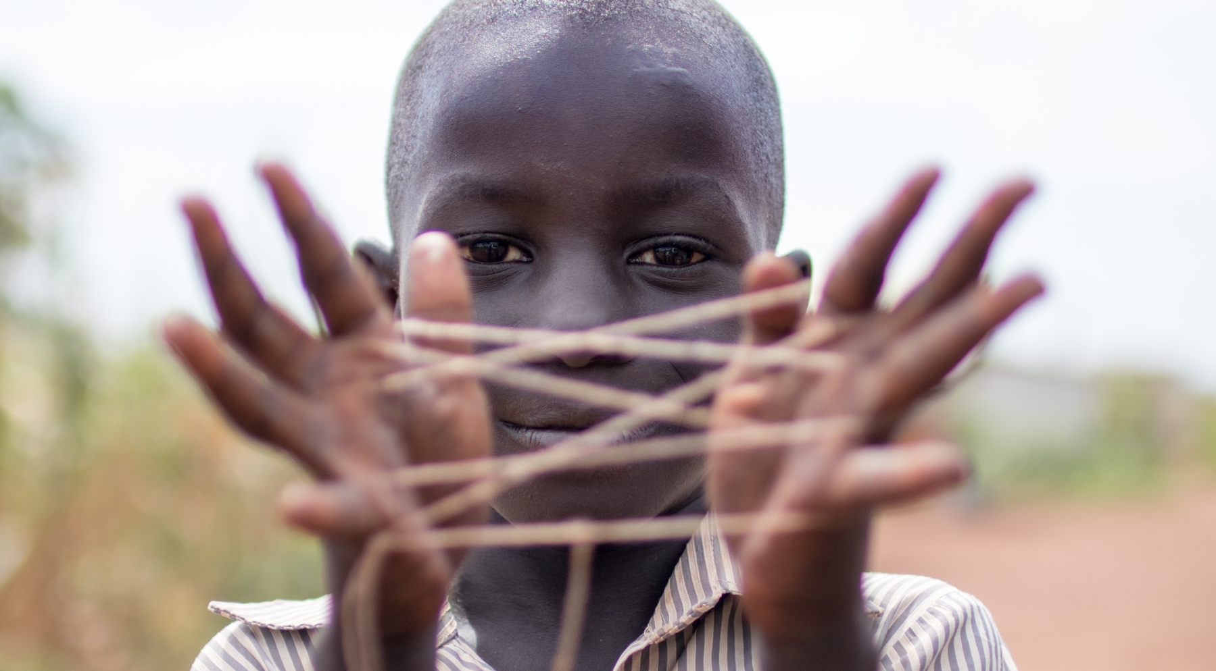
Notes:
Already today we can make connections based on what we have learned from different perspectives. We have heard what the general public has said about the children of Mississippi as well as what has been reported by parents. We have heard about how important it is to share resources with families in our state, and we have seen what happens when early screenings are missed. We’ve even heard about the challenges that Covid-19 has presented households with children in Mississippi. What we do next with all this information goes back to essential skills that emerged early in our own lives.
There are many essential skills that emerge early in life and these skills must be promoted. However, it is never too late. Children and adults can learn these skills at any age. You will see throughout our time together today how I constantly switch between how we develop this skill in our work and how we promote it to our youngest Mississippians. These skills truly do build on one another. For example, executive function involves not only paying attention but also working memory. That is holding information in your mind so you can work with it. Considering something from different points of view is also a part of executive function called cognitive flexibility. Lastly, inhibitory control is the part of our executive function that keeps us from going on automatic so we can continue to work to reach goals. So, the perspective taking we will be talking about today builds off of the executive function life skill.

Slide 4
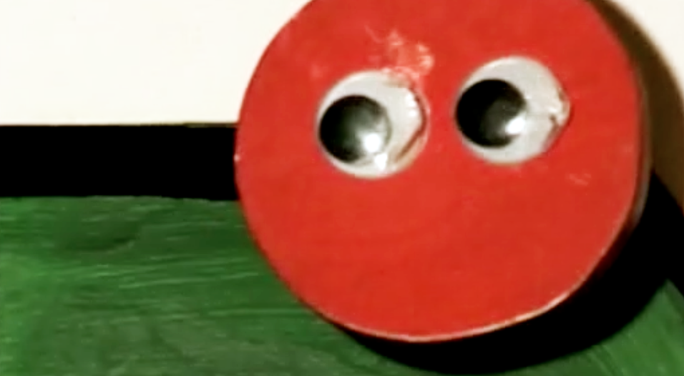
A Study by
Hamlin, Wynn
and Bloom
Infants demonstrate the very
Beginnings of perspective taking.
Notes:
We have been practicing the way we see others for many years. This skill of adopting a new perspective, is a deep and innate part of who we are. I would like to share the work of Kiley Hamlin, Karen Wynn, and Paul Bloom. Their work shows how infants demonstrate the very beginnings of perspective taking.
Babies seem to have an attraction to helpful, pro-social individuals and also a real aversion to anti-social, unhelpful individuals. In the first year of life they are already making judgements about what is in the mind of another individual.
It is interesting to note here that those that presented the shapes did not observe the interaction of the shapes the baby did. Also, even when the shapes were switched and different shapes represented the helpful or unhelpful character the results remained the same. So, the results were not skewed because babies preferred one shape or color over another. The only factor that changed these results was when the googly eyes were removed which tells us the babies were in fact relating the shapes with googly eyes to “people-like” characters.

Slide 5


Preschoolers can understand
that others can know different
things than they know.
Mistaken Beliefs
Alison Gopnik
Notes:
What if a crayon box could also help us learn how perspective taking skills emerge in early childhood.
Alison Gopnik presented a closed crayon box and asked children what they thought was inside. As expected, children answered crayons. However, when the box was opened children discovered there were actually paper clips inside. When children were asked what would happen when a classmate was asked the same question preschoolers answered paper clips which shows that they were unable to truly grasp the concept of others perspectives yet. However, older children reported that their classmates would think there were crayons in the box just as they had.

Slide 6
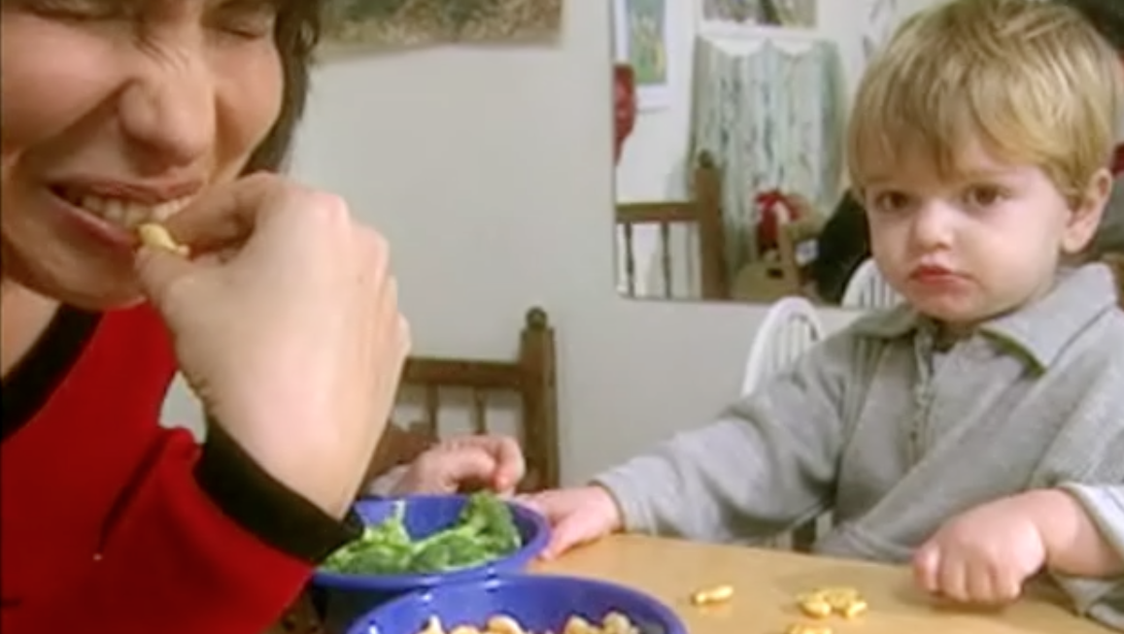
Very young children
can understand that
others have different
likes and dislikes.
Broccoli and Crackers
Alison Gopnik
Notes:
Next, Alison Gopnik presented children with crackers and broccoli. She clearly demonstrated which she preferred to the child. Then, she asked the child to think about which snack she would like the most and hand it to her. Again there was a divide between younger preschoolers and older children. The younger preschoolers gave her the crackers that they preferred even though she indicated she preferred broccoli. However, the older children gave her the broccoli even though they munched away on crackers.
All of this shows that the understanding that others can think differently than we do emerges in early childhood.

Slide 7
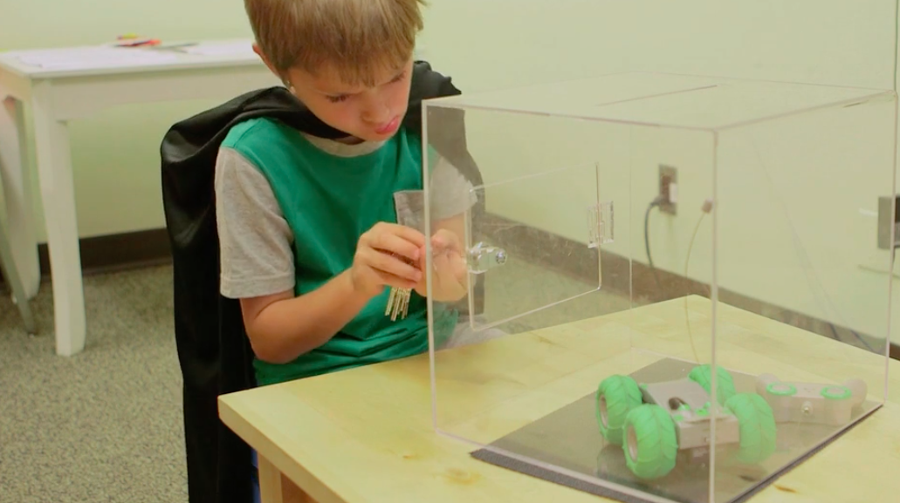
What Would
Batman Do?
Stephanie M. Carlson
Factors That Matter:
Persistence in Difficult Situations
Notes:
Lastly, we can continue to see how perspective taking is a skill that develops in early childhood with the What Would Batman Do study. In this research Stephanie Carlson shows how children can take a broader perspective and in turn not just go with their automatic, knee jerk reactions. The children were given a frustrating task to complete, but first asked if they would like to do the task as a character. Most chose batman. They were given props to make them feel more like the character and then told to began the task. Results from this research show that children had a 12 month advantage in their abilities to do the task as opposed to children their age who did the task without being given the option to do the task as a character. A full year! Perspective taking is a skill we must promote in children so it is developed and it is a skill we can use in the way we communicate about the early years.
So, it’s really not just about how we see things….it’s really about what our brain perceives. Our brain is constantly integrating information about our life’s experiences so that we can make probabilistic decisions. However, we all have slightly different information going into that equation. You can be biased to see information differently from someone else.
There is POWER and OPPORTUNITY in understanding these differences. If we can understand that we can see, hear, and feel the exact same information in entirely different ways – we have an opportunity and a chance to CHANGE! BUT We must be willing to fundamentally think differently about the interactions we will have so we can truly make connections with others.
It is not easy. Making these connections means we have to be vulnerable and we do not like to be vulnerable. So, let me take just a moment to be vulnerable with you…. I originally planned to tell this story to begin my talk today:
A shoe manufacturer decided to expand his market so he sent two sales assistants to an undeveloped territory. One messaged back: "Prospect here is nil. No one wears shoes." The other reported enthusiastically, "Market potential is terrific! Everyone is barefooted.“
My heart was in the right place and this story does illustrate that two people can be given the same information and see things entirely differently. However, I quickly realized after hearing from a friend that to someone who has been made fun of because “people in Mississippi don’t wear shoes” or to someone who has lived overseas where shoes are truly a status of wealth in a land where there is need that this illustration means something completely different to them and can even be hurtful or at the least it could completely misconstrue the entire message I am trying to send. We never just “arrive” at this skill. Perspective taking is POWERFUL and it does give us the opportunity to CHANGE. And that change has to start with ME. Before we can help families and caregivers work with children to develop this skill. . It has to start with us. Our own perceptions and the way we communicate them (intentionally or not) influences the development of the perceptions young children have.

Slide 8

HOPE
Notes:
Another example that hits home with how we communicate about the early years deals with how we talk about Adverse Childhood Experiences. These experiences can include things like physical and emotional abuse, neglect, caregiver mental illness, and household violence. Understanding the role of this in early child development has truly been a game changer, but we must think about how those who have had these experiences will react to how we describe them. We must make sure that we convey the HOPE that is possible through overcoming challenges and the resilience of the developing child. We also must make sure that we don’t begin to use this term or the trauma in someone’s life as a way to label someone or make assumptions about them. We must instead build on children’s and families’ assets instead

Slide 9

Do you see what I see?
Notes:
So, Think of what we can accomplish if we use this skill to the fullest. A positive perspective is so important. We also heard about this from the qualitative report about Mississippians and their aspirations for children. No matter our background and differences what unites us is that we want what is best for the children of Mississippi. If we shift our language and frame our messages to focus on the assets of the children and families we support, we’ll see more opportunities for change. So, as we are communicating about the early years and framing our messages lets take on the perspectives of our families and children in this great state. If you could see, hear, and feel someone else’s alternative reality today and question your own perspectives….what would you change?
------------------------------------------------------------------------------------------------------------------------------------------------------------------------------------------------------------------

Slide 10
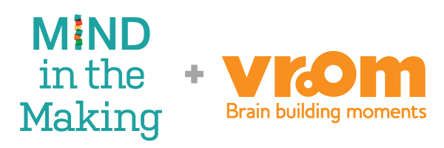
Photographs
by Unsplash and Mind in the Making
Use of these Mind in the Making Seven Essential Life Skills Module materials (guidebooks, PowerPoint files, videos, handouts, etc.) is intended for the recipients’ internal purposes only. By receiving and using this material, the recipient recognizes that the Bezos Family Foundation owns the copyright for Mind in the Making materials in accordance with the law. The discretion to use any and all Mind in the Making materials and logos rests solely with the Bezos Family Foundation. These written materials, videos, PowerPoint slides and photos cannot be recopied, edited, posted, or shown on public media without the express written consent of the Bezos Family Foundation. Additional information about the use of video content can be found at Mind in the Making Terms of Use document in the thumb drive.
Copyright © 2020 Bezos Family Foundation
Notes:
Perspective Taking is just one of Mind in the Making’s seven essential life skills. You can find out more from Mind in the Making about the other life skills that can help children and adults thrive now and in the future. You can also visit Vroom to find out more about fun, free, and fast tips and activities to support families with young children.

Slide 11



Heather
Martin
heather.martin@ ssrc.msstate.edu
This presentation is supported by the Health Resources and Services Administration (HRSA) of the U.S. Department of Health and Human Services (HHS) as part of an award totaling $14 million with 0 percent financed with non-governmental sources. The contents are those of the author(s) and do not necessarily represent the official views of, nor an endorsement, by HRSA, HHS, or the U.S. Government. For more information, please visit HRSA.gov.
Notes:
Please don’t hesitate to contact me if I can help you or your organization.

